Slide 1
Creative Coding Club
Code Anything You Can Think Of
First Meetup 11/2/2018
Second Meetup 25/2/2018
Third Meetup 11/3/2018

Slide 2
House Keeping
Emergency Exit
Safety:
Never short-circuit: Red wire + black wire = FIRE!
Reverse polarity = FRIED BOARD
Always disconnect when you tinker with electronics
Check and double check your wiring
In case of incident, switch off power supply, ask for help

Slide 3
How are we different?
No specific technology / platform
Very practical, focus on software development side of things
A coding dojo

Slide 4
Club Activities
"Code Anything You Can Think Of" Fortnight workshops
Crash courses / Bootcamps:
Beginning Arduino
Internet of Things with ESP8266
Python
Web development
Hackathons

Slide 5
Suggested Agenda
1pm Set up. Intro. Housekeeping.
1.15pm What is coding?
1.30pm Hook up and upload your first Arduino program
1.45pm Practical electronics & coding
2.15pm Topic of interest
2.30pm Hack and tell
2.45pm Pack up and prepare to continue coding at home

Slide 6


Slide 7


Slide 8
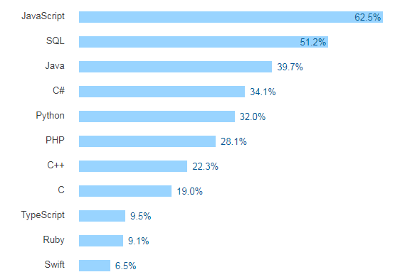
Top 10 Languages to Learn in 2018

Slide 9


Slide 10
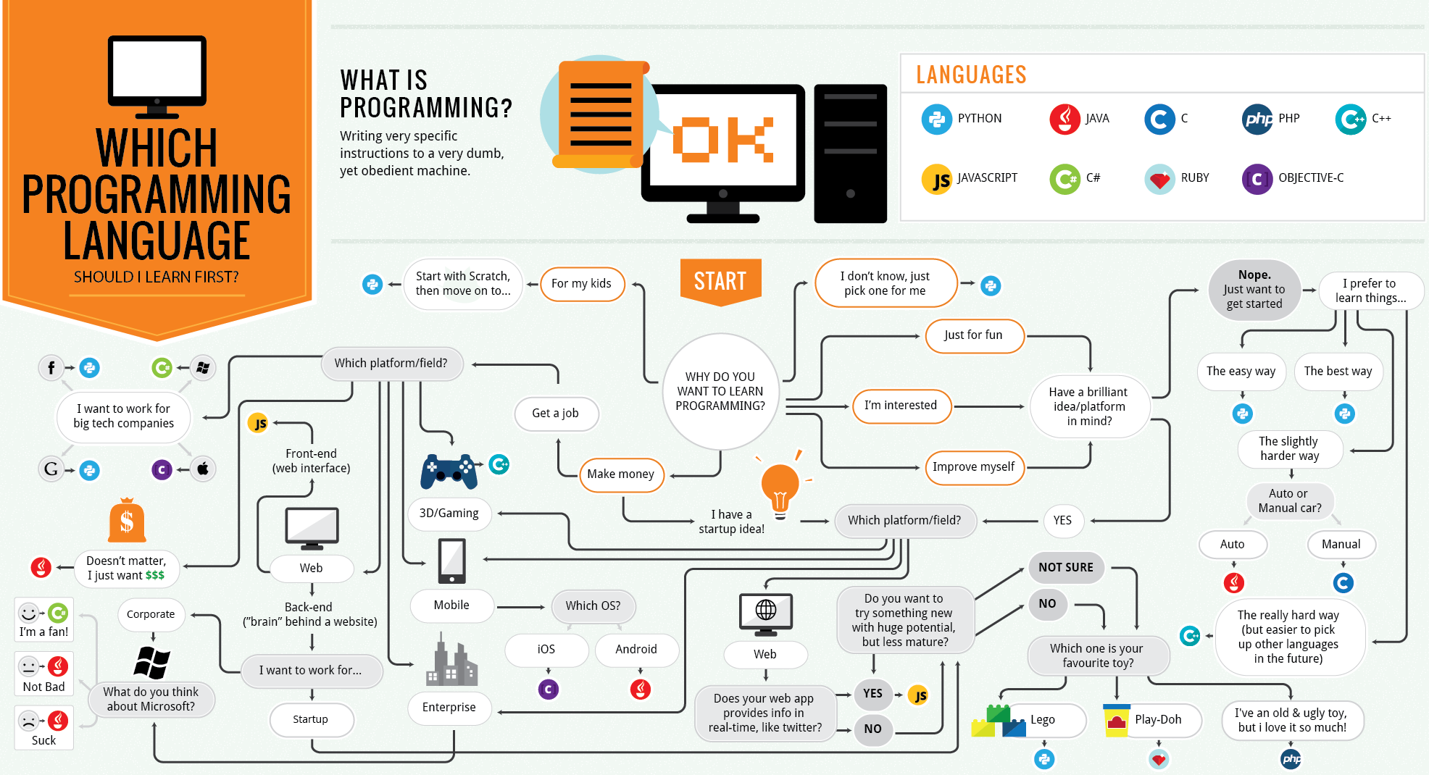

Slide 12
Easiest Ways to Learn Coding
Free Resources:
CodeAcademy.com
CodeWars.com
FreeCodeCamp.com
Online classes:
Udacity - Nanodegrees
Harvard University's Edx CS50
Join coding clubs and meetups
Find a mentor / hire personal tutor
Just start

Slide 13
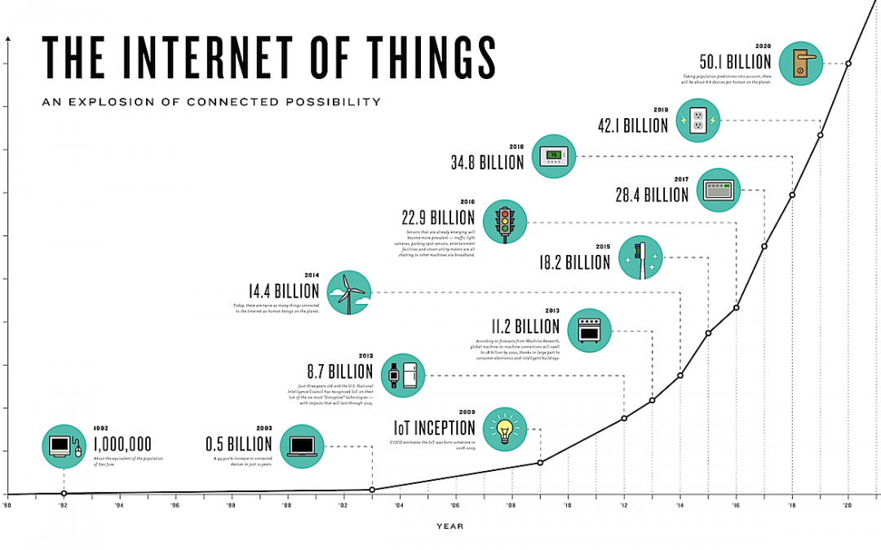

Slide 14
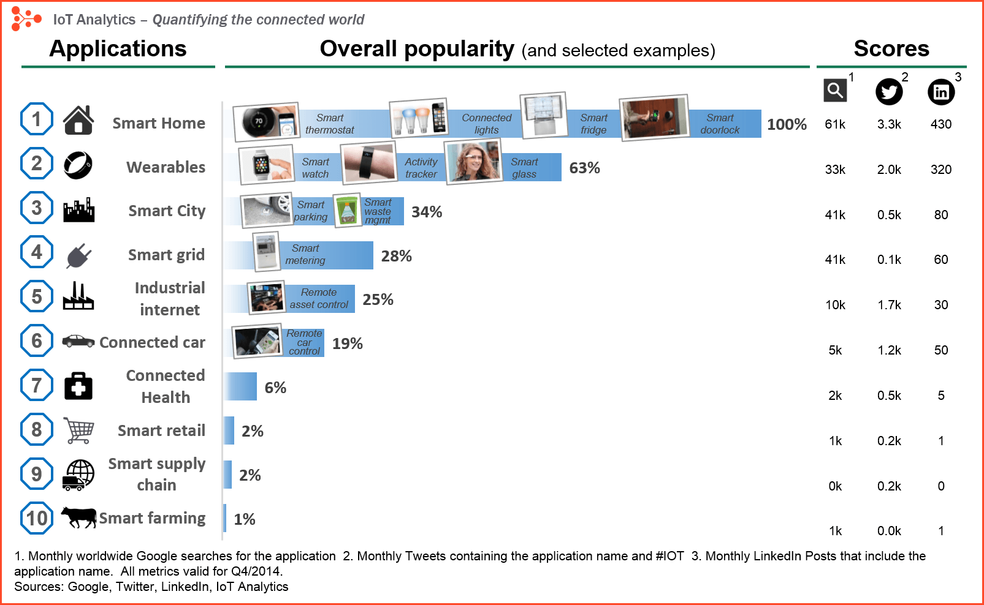

Slide 15
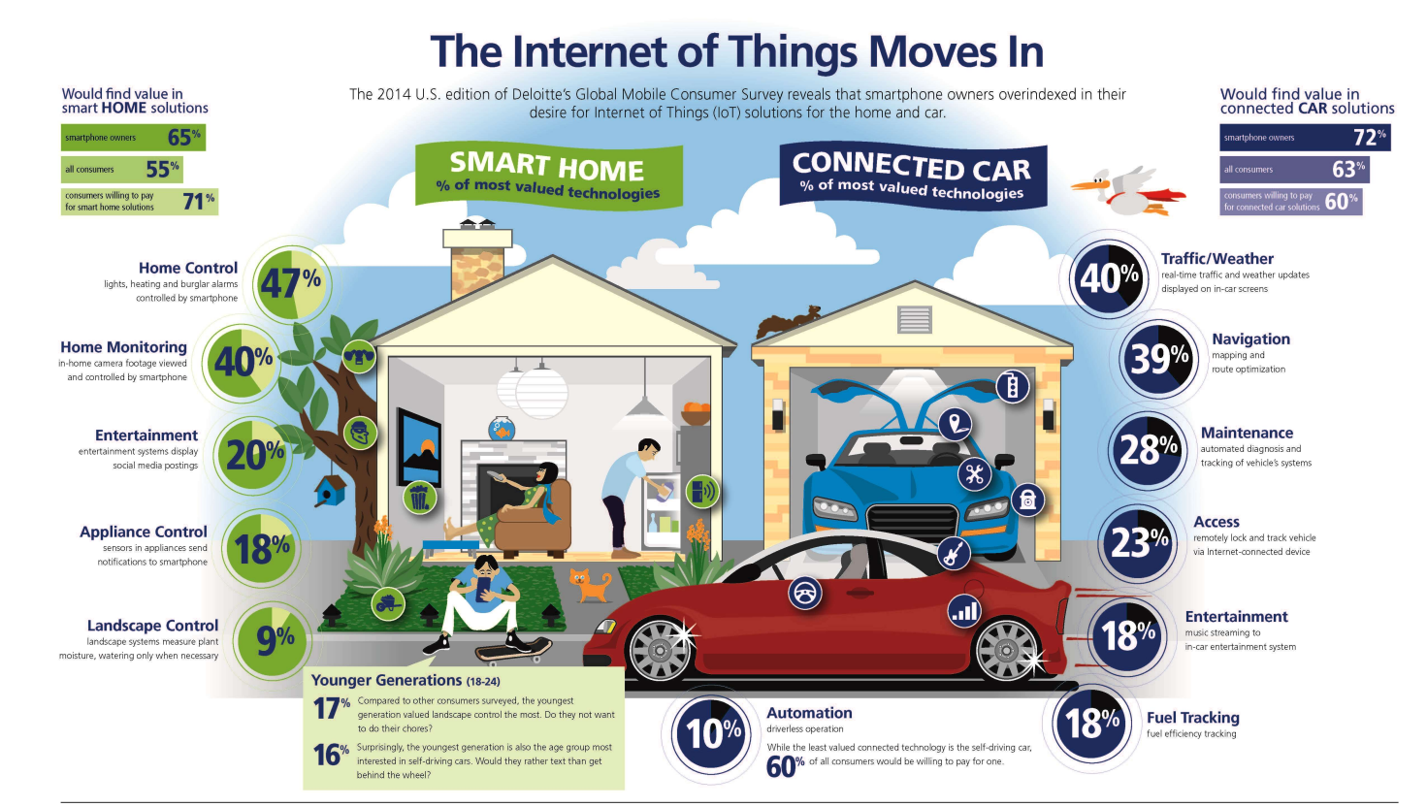
Source: Deloitte website

Slide 16
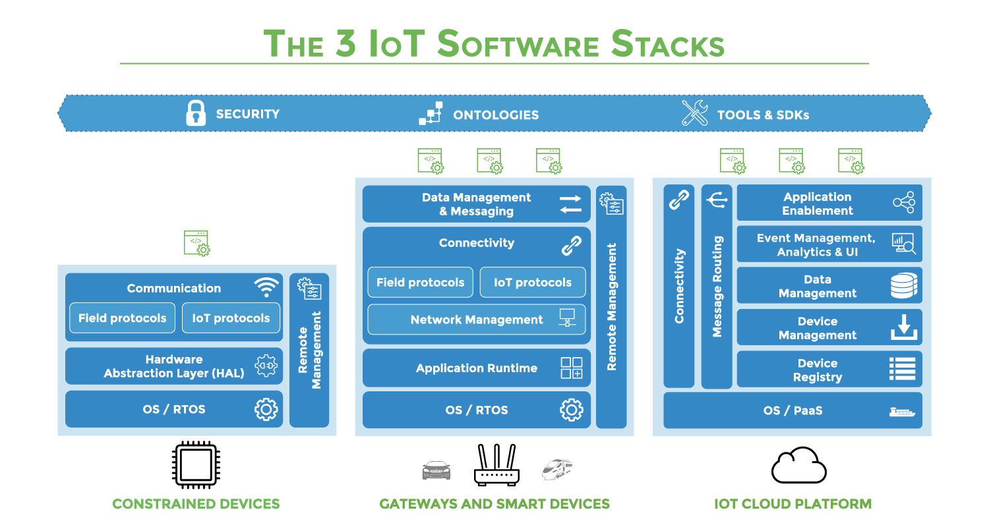

Slide 17
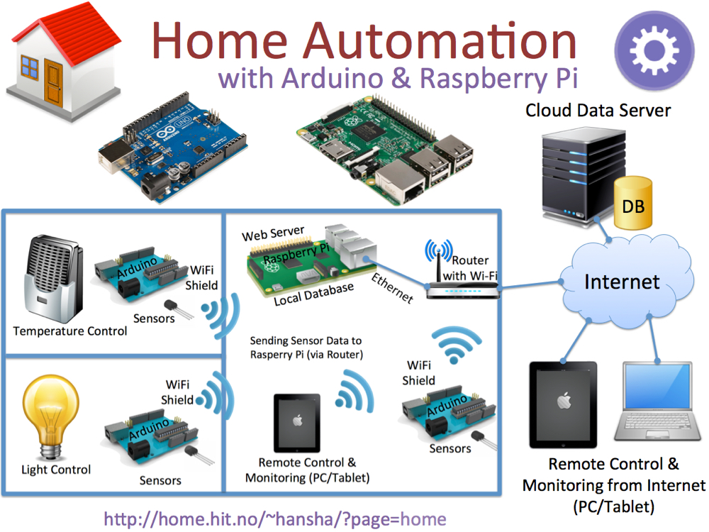

Slide 18
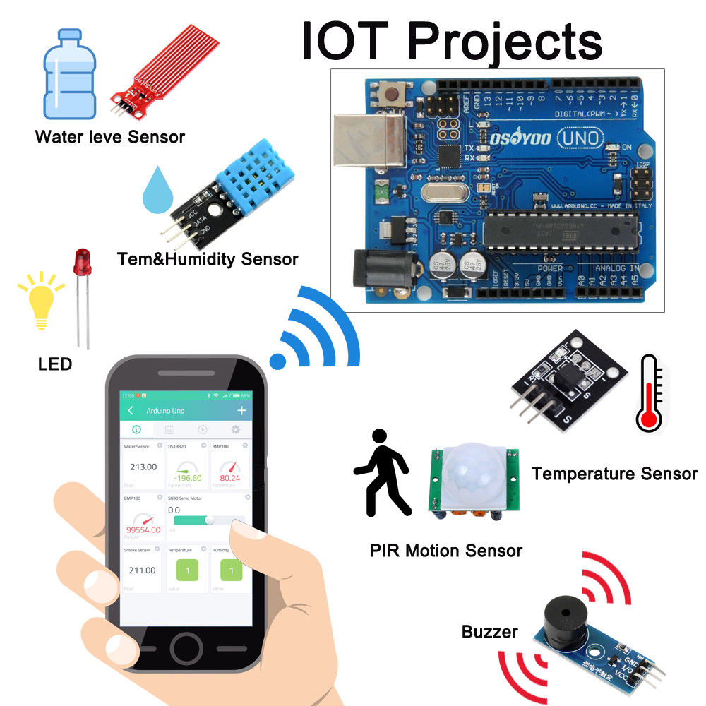

Slide 19
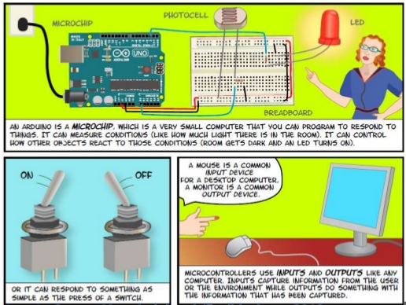

Slide 20
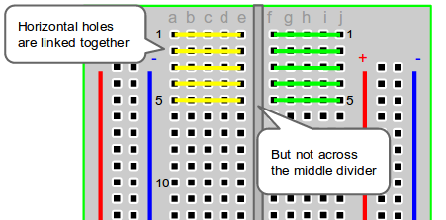
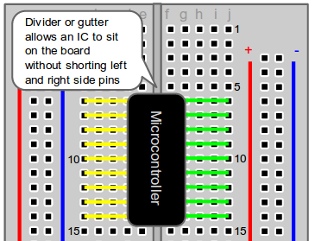
The Breadboard - Horizontal Columns

Slide 21
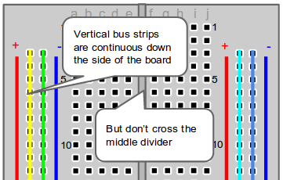
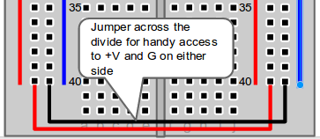
The Breadboard - Vertical Columns

Slide 22
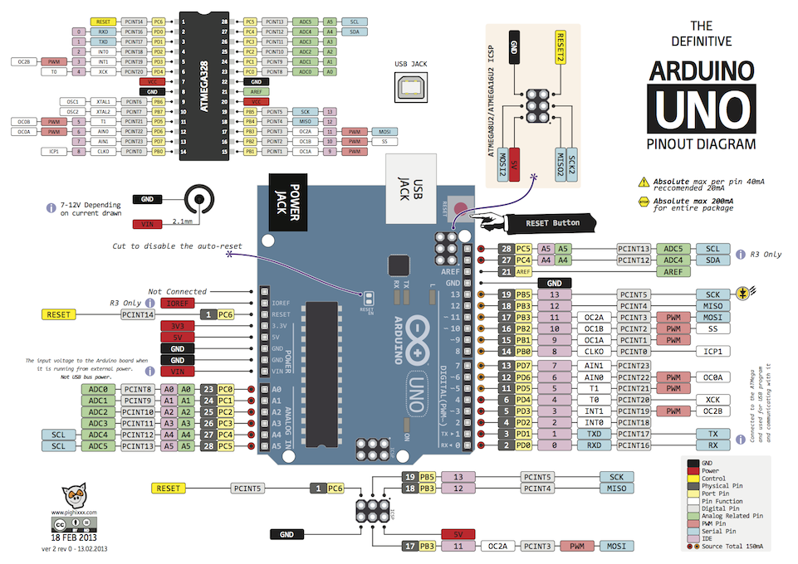

Slide 23
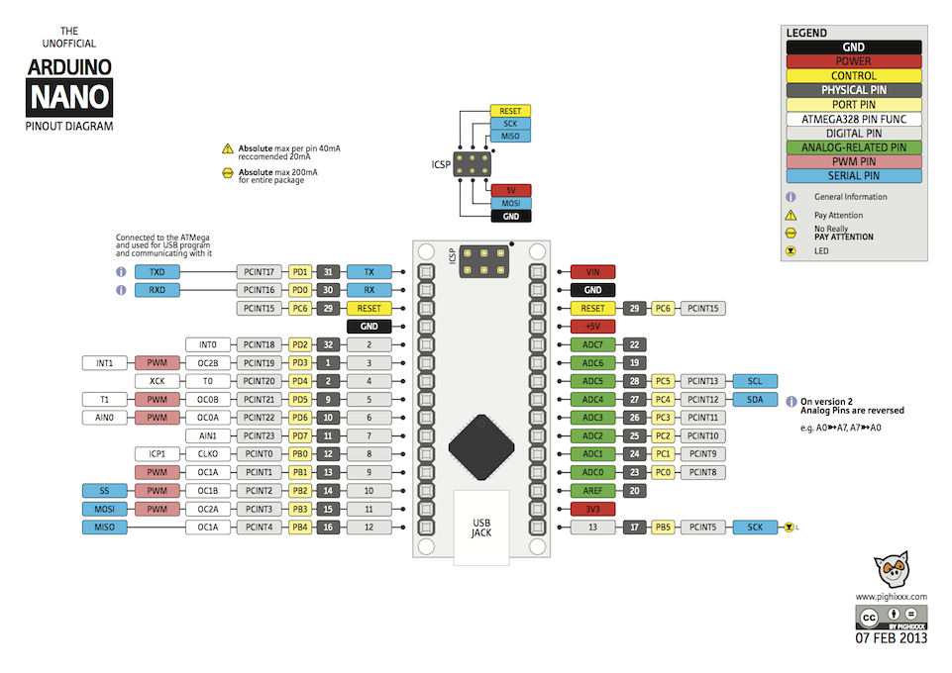

Slide 24
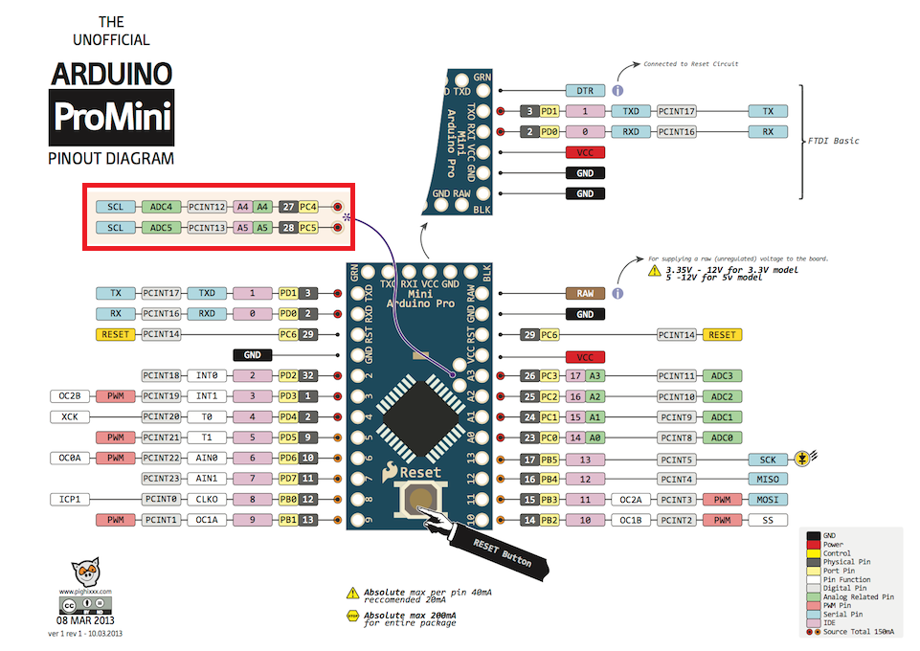

Slide 25
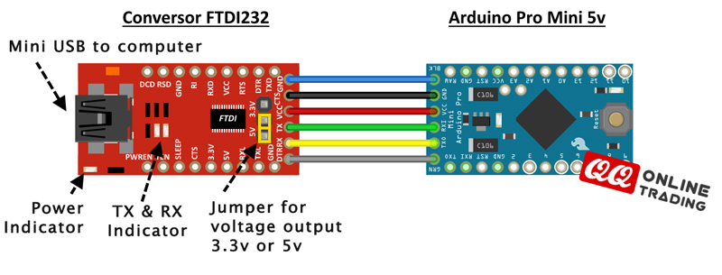
Uploading onto ProMini - FTDI232 programmer

Slide 26
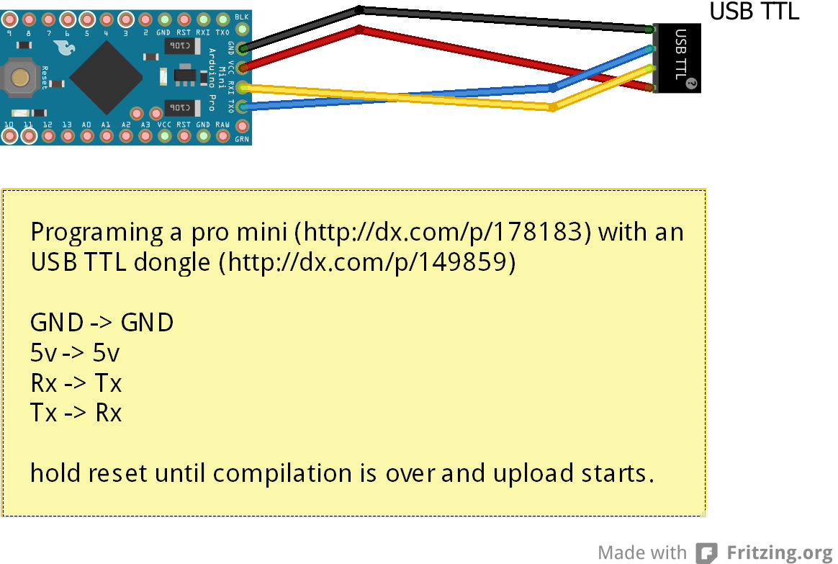
Uploading onto ProMini - USB TTL dongle

Slide 27
Let's get coding
1. Blink a LED
2. Push button
3. Light sensor
4. Buzz a buzzer
Guides and References are in comment section:
https://www.meetup.com/CreativeCodingClub-MelbourneSouthEasternSuburbs/events/247111498/

Slide 28
Coding Challenge: BEER THEFT DETECTOR
You live in a shared accomodation, where you share a fridge with 3 others. You want to build a simple, offline Internet of Thing to detect and alert you when someone is stealing your beer. How do you use Arduino, LED, a button, a buzzer, and a light sensor to design and build a BEER THEFT alarm?

Slide 29
Reference and resources
https://www.allaboutcircuits.com/projects/learn-how-to-use-the-arduinos-digital-i-o/
https://www.makeuseof.com/tag/getting-started-with-arduino-a-beginners-guide/
https://computers.tutsplus.com/tutorials/how-to-use-a-breadboard-and-build-a-led-circuit--mac-54746
Arduino.cc
Charlcheo.com/startcoding
Various infographics on Pinterest

Slide 30
Next Meetup
Sunday 11 March 1-3pm
OfficeWorks Carnegie
Topics:
Serial communications
Wireless communications fundamentals
Bluetooth
Radio
Wifi

